Slide 1
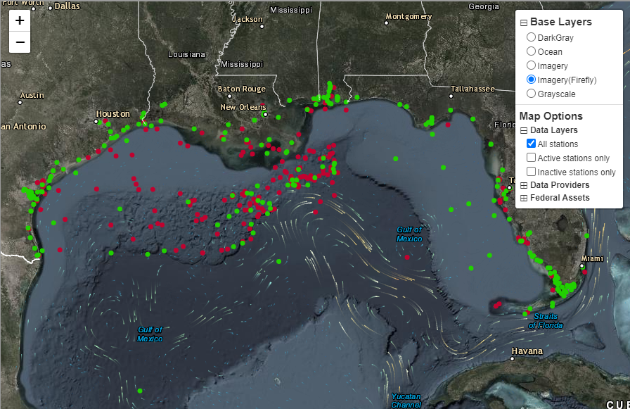
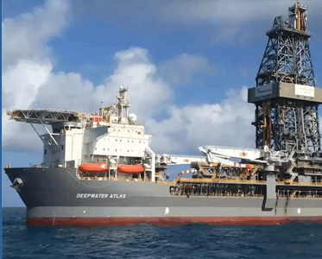
(as of May. 2023)
Data Providers: 59 organizations
Stations : 253 LDN + 182 Fed
Sensors : 1,616

Slide 2
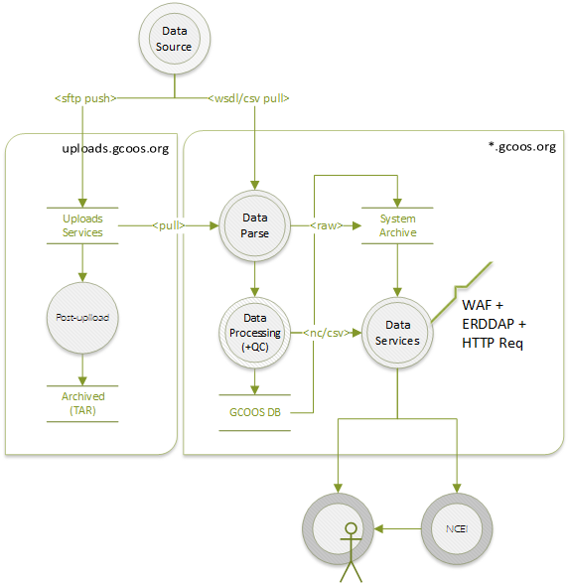
Generic Data Flow

Slide 3
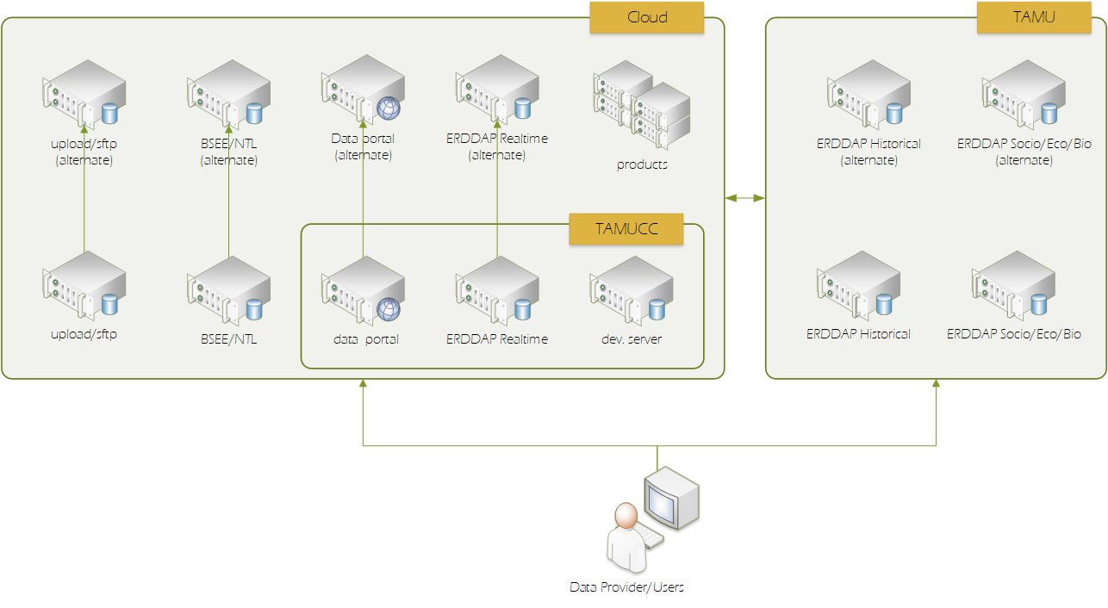
Network/Architecture

